Slide 1
annual data collection: key changes
Communication to reporting institutions
October 2022

Slide 2
Q4-2022 ANNUAL COLLECTION: KEY CHANGES
Changes (1/5)
Threshold for Relevant Legal Entities (RLEs) in scope
One of the criteria to identify RLEs for reporting purposes has been updated: the Total Assets threshold decreases from EUR 10bn to EUR 5bn (see Section 1 of the LDR Guidance¹).
New consolidation level
The consolidation level (IND, CON, RES, INDPOE, CONPOE) is moving from “taxonomy reporting module” to “identifier”, in line with the application of the EBA 3.2 Framework². Consequently, the number of reporting modules has been reduced from 12 to 4 (CIR, FMIR, LDR, CIR), and the submission filename will change as indicated below:
¹ For more information, please refer to: https://www.srb.europa.eu/en/content/2023-resolution-reporting
² https://www.eba.europa.eu/risk-analysis-and-data/reporting-frameworks/reporting-framework-3.2

Slide 3
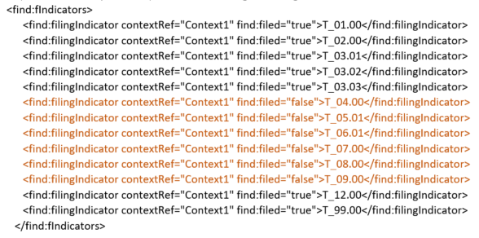
Q4-2022 ANNUAL COLLECTION: KEY CHANGES
Changes (2/5)
Change in the filing indicator obligation
An XBRL report MUST provide a filing indicator for each tab defined in the reporting module. In particular, LDR reporting module has 13 tabs (T 01.00, T 02.00, T 03.01, T 03.02, T 03.03, T 04.00, T 05.01, T 06.01, T 07.00, T 08.00, T 09.00, T 12.00, T 99.00). The XBRL submission for CON, RES, INDOTH, in which tabs T04.00, T05.01, T06.01, T07.00, T08.00, T09.00 are not permitted, must contain a negative filing indicator for each of these tabs:
Reporting institutions are expected to implement the necessary changes, otherwise the file will be rejected

Slide 4
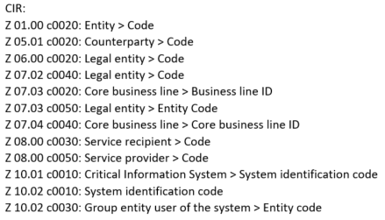
Q4-2022 ANNUAL COLLECTION: KEY CHANGES
Changes (3/5)
Greyed-out cells in LDR T 01.00
The following cells in the LDR T 01.00 have been greyed-out (= no values can be reported), in order to map the SRB T01 to the EBA RESOL Z02:
Empty string in key column is not allowed
In the past a validation rule was checking whether such field was filled in. Now this feature has been added as a core feature of the EBA taxonomies through the new type “notEmptyString”. This is the list of the impacted reports:

Slide 5
Q4-2022 ANNUAL COLLECTION: KEY CHANGES
Changes (4/5)
LDR validation rules: some rules have been updated/added
CFR validation rules: quantitative and existence checks have been added (moved from L3 to L2)
FMIR label: update of the label in the picklist T 30.00 – c0050 (eba_x125) from "Cassa di Compensazione e Garanzia (CC&G)" to "Euronext Clearing"
EBA filing rules:

Slide 6
Q4-2022 ANNUAL COLLECTION: KEY CHANGES
Changes (5/5)
Signature changes:

Slide 7
Thank you!

